Slide 1

Subject: Cloud Web Services
Module Number: 02
Module Name: Introduction to EC2
1

Slide 2
Introduction to EC2
AIM:
The aim of this module is to introduce students about Amazon EC2 and different types of Instances.
1

Slide 3
Introduction to EC2
Objectives:
The objectives of this module are:
Introduction to EC2 and Different Instances
Understanding of Amazon Machine Images
Knowledge of Elastics Block Storage
Explanation of Elastic IPS, Route 53 DNS System and CloudFront SNS Pricing
1

Slide 4
Introduction to EC2
Outcome:
At the end of this module, you are expected to:
Understand about EC2 instance.
Different types of Instances.
Knowledge of Amazon Machine Images.
Learn about Elastics Block Storage.
Knowledge of Route 53 DNS System.
1

Slide 5
Introduction to EC2
Contents
Introduction to EC2
Instance Types
Amazon Machine Images
Introduction to EBS
Introduction to Elastic IPs
Route 53 DNS
Simple Notification Service
1

Slide 6
Introduction to EC2
Introduction to EC2
1

Slide 7
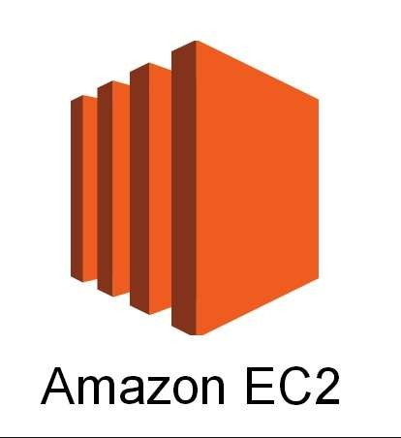
Introduction to EC2
What is EC2?
Amazon Elastic Compute Cloud (Amazon EC2) provides scalable computing capacity in the Amazon Web Services (AWS) cloud.
Amazon EC2 provides different instance types to enable you to choose the CPU, memory, storage, and networking capacity that you need to run your applications.
Amazon Elastic Compute Cloud (Amazon EC2) Run Command lets you remotely and securely manage the configuration of your Amazon EC2 instances, virtual machines (VMs) and servers in hybrid environments, or VMs from other cloud providers.
1

Slide 8
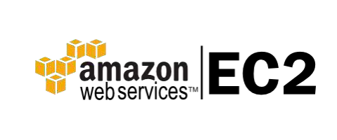
Introduction to EC2
What is EC2?
Amazon Elastic Compute Cloud (Amazon EC2) is a web service that provides secure, resizable compute capacity in the cloud. It is designed to make web-scale cloud computing easier for developers.
Using Amazon EC2 eliminates your need to invest in hardware up
front, so you can develop and deploy applications faster.
You can use Amazon EC2 to launch as many or as few virtual servers as you need, configure security and networking, and manage storage.
Amazon EC2 enables you to scale up or down to handle changes in requirements or spikes in popularity, reducing your need to forecast
traffic.
8

Slide 9
Introduction to EC2
Why EC2?
On the Go Pricing
Amazon took a refreshing approach to pricing its hosting when launching AWS. Every service is "a la carte", meaning you pay for what you use. This makes a lot of sense for server infrastructure, as traffic tends to be very busty, especially the larger the site is.
Traditional hardware, for the most part, goes unutilized for 90% of its lifecycle. AWS helps deal with this problem by keeping it cheap during the slow times.
The Free Tier
The free tier, which provides enough credit to run an EC2 micro instance 24/7 all month, resolves this. It comes with S3 storage, EC2 compute hours, Elastic Load Balancer time, and much more.
This gives developers a chance to try out AWS's API in their software, which not only enhances their software, but also ties them to AWS, which benefits Amazon in the long run.

Slide 10
Introduction to EC2
Why EC2?
Automation
As a hosted continuous deployment service releasing changes and scaling automatically is a necessity.
When automating the whole process of deployment and scaling we can provide a much better
service with fewer points of failure and faster recovery in case of an error.
Additionally it allows us to decouple the scaling of our infrastructure with scaling our team.
We simply do not have to hire additional server admins because we run a much larger infrastructure.
Scaling
We want to be able to scale to any size at any time without limiting ourselves by having to set up or manage physical servers.
A cloud provider with good automation support was thus the only viable route to go for us.

Slide 11
Introduction to EC2
Why EC2?
Security
Access to the AWS resources can be restricted using the IAM (Identity and Access Management), using the roles in IAM we can define the privileges for user actions which greatly reduces any malpractices.
AWS also provides VPC, which can be used to host our services on a private network which is not
accessible from the internet, but can communicate with the resources in the same network.
This restricts the access to the resources such that any ill intentioned user from the internet.
These resources hosted in the private network can be accessed using the Amazon VPN or some open source service like Open VPN.
Deployment Scaling
AWS shrinks that deployment time to minutes. If you utilize their Amazon Machine Images, you can have a machine deployed and ready to accept connections in that short amount of time.
This is important when, for example, you are running a promotion that generates tons of traffic at specific intervals, or just need the flexibility to handle the demand when a new product launches.
The Cloud formation Templates is a gift from the AWS which can be used to roll out multiple environments at the click of button and as well can be rolled down at the click of a button when the requirement recedes.
11

Slide 12
Introduction to EC2
Features in EC2
Amazon EC2 provides the following features:
Virtual computing environments, known as instances.
Preconfigured templates for your instances, known as Amazon Machine Images (AMIs), that package the bits you need for your server (including the operating system and additional software).
Various configurations of CPU, memory, storage, and networking capacity for your instances, known as instance types.
Secure login information for your instances using key pairs (AWS stores the public key, and you store the private key in a secure place).
Storage volumes for temporary data that's deleted when you stop or terminate your instance, known
as instance store volumes.
12

Slide 13
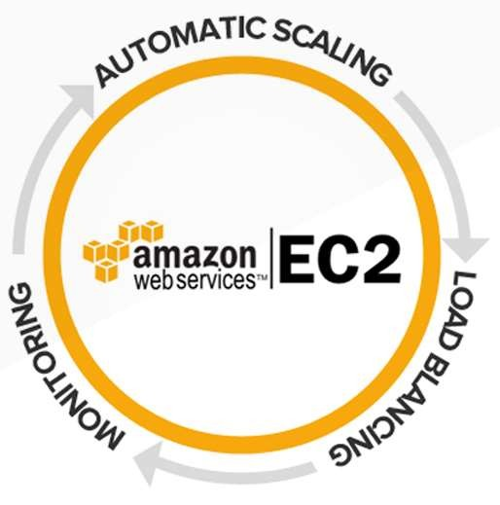
Introduction to EC2
Features in EC2
Persistent storage volumes for your data using Amazon Elastic Block
Store (Amazon EBS), known as Amazon EBS volumes.
Multiple physical locations for your resources, such as instances and Amazon EBS volumes, known as regions and Availability Zones.
A firewall that enables you to specify the protocols, ports, and source
IP ranges that can reach your instances using security groups.
Static IPv4 addresses for dynamic cloud computing, known as Elastic IP addresses.
Metadata, known as tags, that you can create and assign to your
Amazon EC2 resources.
Virtual networks you can create that are logically isolated from the rest of the AWS cloud, and that you can optionally connect to your own network, known as virtual private clouds (VPCs).

Slide 14

Introduction to EC2
EC2’s Unique Nature
EC2 has come up with its own terminology: When a virtual machine is running in EC2, it’s referred to as an instance; when an instance isn’t running in EC2, it’s referred to as an image.
The implication is that you may have wasted disk storage. If you have, say, a virtual machine with 1.7GB of disk space but the virtual machine operating system and application software require only 300MB of disk space — you have 1.4GB of unused storage and by extension, 1.4GB of wasted disk space.
EC2, by contrast, stores only the actual data necessary to provide the virtual machine and operating system, so only 300MB is stored on disk when the instance is not running — and, crucially, you don’t pay for the 1.4GB of unused disk space that otherwise would sit empty.
This arrangement reduces your EC2 cost when your instances are not
running.

Slide 15
Introduction to EC2
Instance Types and Uses

Slide 16
Introduction to EC2
AWS EC2 Instance Types: T2
T2 are Burstable Performance Instances that offer a baseline level of CPU performance with the capability to burst above the baseline.
The ability to burst and baseline performance are directed by CPU Credits.
Every T2 instance regularly gets CPU Credits at an established rate that is based on the size of the
instance.
These instances accrue CPU Credits as and when they become idle, and utilize the CPU credits as and when they become active.
These instances are a better option for workloads that do not require the full CPU consistently but rarely
requires bursting.
These instances are suitable for general purpose workloads like developer environments, small databases, and web servers.

Slide 17
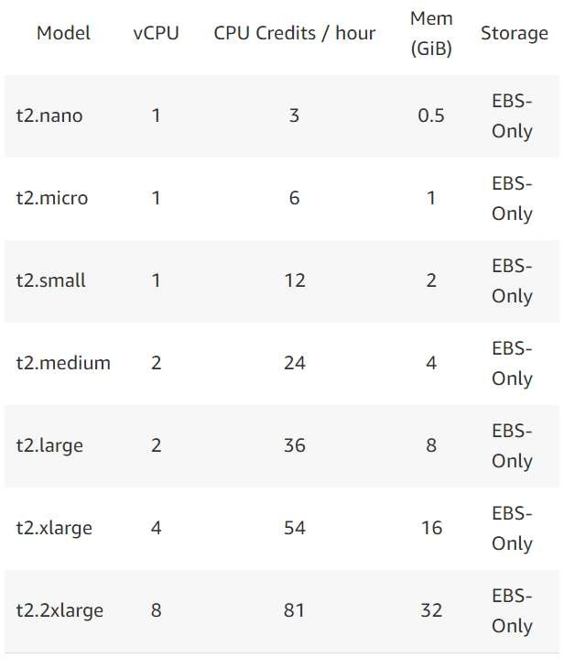
Introduction to EC2
AWS EC2 Instance Types: T2
Features:
High frequency Intel Xeon processors
Burstable CPU, governed by CPU Credits, and consistent baseline performance
Lowest-cost general purpose instance type, and Free Tier eligible
Balance of compute, memory, and network resources

Slide 18
Introduction to EC2
AWS EC2 Instance Types: M4
M4 instances are the most recent general purpose instances.
The M4 family of instances offers a balance of memory, network, and compute resources, and it is a better option for several applications.
They have custom Intel Xeon E5-2676 v3 Haswell processors that are optimized explicitly for EC2.
The clock rate for these instances can be in the range of 2.4 GHz to 3.0 GHz with the aid of Intel Turbo
Boost.
M4 instances also provide Enhanced Networking that gives up to four times the packet rate of instances without Enhanced Networking, while guaranteeing reliable latency, even under high network I/O.
When inside the placement groups, the Enhanced Networking decreases the average latencies among
instances by 50 percent or even more.
By default, these instances are EBS-Optimized and have a devoted network capacity for Input/Output operations.

Slide 19
Introduction to EC2
AWS EC2 Instance Types: M4
large:
This is the latest generation of general purpose instances.
It has 8 GiB memory and only supports EBS storage.
It has a dedicated EBS bandwidth of 450 Mbps and two vCPUs.
xlarge:
This instance has double vCPU than the m4.large instance, i.e. four vCPU.
It also only supports EBS SSD storage.
It has 16 GiB memory and 750 Mbps bandwidth of dedicated EBS.
2xlarge:
The 2xlarge instance supports enhanced networking with 1000 Mbps dedicated EBS bandwidth.
It has eight vCPUs and supports 32 GiB memory.
It offers storage only for EBS SSD.

Slide 20
Introduction to EC2
AWS EC2 Instance Types: M4
4xlarge:
This instance has 16 vCPU and 64 GiB memory.
With no additional cost, the 4xlarge instance only supports EBS SSD storage.
It has dedicated EBS bandwidth of 2000 Mbps.
10xlarge:
This is the highest capacity instance.
It has 40 vCPUs and supports 160 GiB memory and dedicated EBS bandwidth of 4000 Mbps.
Like other m4 instances, it only has EBS SSD.

Slide 21
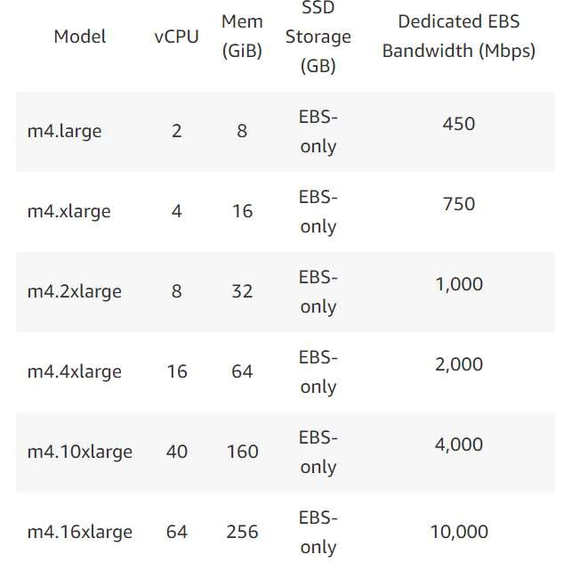
Introduction to EC2
AWS EC2 Instance Types: M4
Features:
2.3 GHz Intel Xeon® E5-2686 v4 (Broadwell) processors or 2.4 GHz Intel Xeon® E5-2676 v3 (Haswell) processors
EBS-optimized by default at no additional cost
Support for Enhanced Networking
Balance of compute, memory, and network resources

Slide 22
Introduction to EC2
AWS EC2 Instance Types: M3
The M3 instance type offers a balance of memory, network, and compute resources.
These instances are for general purpose virtual machines, and most of the EC2 instances belong to
this category.
M3 instances are suitable for mid-size and small databases, data processing jobs that require extra memory, running backend servers for SAP, cluster computing, Microsoft SharePoint, and several other applications.

Slide 23
Introduction to EC2
AWS EC2 Instance Types: M5
M5 instances are the latest generation of General Purpose Instances.
This family provides a balance of compute, memory, and network resources, and it is a good choice for many applications.
Features:
2.5 GHz Intel Xeon® Platinum 8175 processors with new Intel Advanced Vector Extension (AXV- 512) instruction set.
New larger instance size, m5.24xlarge, offering 96 vCPUs and 384 GiB of memory.
Up to 25 Gbps network bandwidth using Enhanced Networking.
Requires HVM AMIs that include drivers for ENA and NVMe.
Powered by the new light-weight Nitro system, a combination of dedicated hardware and lightweight
hypervisor.
Instance storage offered via EBS or NVMe SSDs that are physically attached to the host server.
With new M5d instances, local NVMe-based SSDs are physically connected to the host server and provide block-level storage that is coupled to the lifetime of the M5 instance.

Slide 24
Introduction to EC2
C4 instance:
These instances are recent additions to the compute-optimized instances that feature maximum performance processors with the lowest compute/price performance in EC2 Instance types.
These instances are suitable for compute-bound applications that derive advantage from high-
performance processors.
C4 instances are ideal for media trans coding, Massively Multiplayer gaming servers, high traffic web
servers, batch processing workloads, and high-performance computing.
C4 instances are dependent on custom 2.9 GHz Intel Xeon E5-2666 v3 processors, which are specifically optimized for EC2.
The Intel Turbo Boost Technology helps clock speed of the C4 instances to touch 3.5Ghz with 1 or 2 core Turbo Boost onc4.8xlarge instances.
24

Slide 25
Introduction to EC2
C4 instances types
large: This compute optimized instance has high performing processors. This model has two vCPUs, dedicated EBS bandwidth of 500 Mbps, and 3.75 GiB memory. It offers storage for EBS only.
xlarge: The xlarge model has four vCPUs and supports EBS storage only. All C4 models can be used for applications of clusters and networking. This model has 750 Mbps dedicated EBS bandwidth and 7.5 GiB memory.
2xlarge: This model of the C4 instance has 1000 Mbps bandwidth of dedicated EBS. It also supports storage of EBS only. This instance has 15 GiB memory and supports eight vCPUs.
4xlarge: With 4xlarge, the default storage is EBS. It has 16 vCPUs and offers 2000 Mbps of
dedicated EBS bandwidth.
8xlarge: This C4 instance has the capacity of controlling C-state and P-state processor configurations. It has 4000 Mbps bandwidth of dedicated EBS, 36 vCPUs, and 60 GiB memory. Likes other C4 models, it only has EBS storage.

Slide 26
Introduction to EC2
C3 instance:
When compared to C1, C3 instances offer much faster processors with about twice the memory per SSD-based and vCPU instance storage.
These instances are suitable for applications that derive advantage from a large amount of compute capacity for memory and are best-fitted for high performing web servers, and several compute- intensive applications.
Compute-optimized instances are a recent introduction from AWS.
The instances are intended to provide maximum performance at an affordable price.
They have per-core performance, which beats those offered by any of the AWS EC2 instance types, with a price-performance ratio that would be the best fit for compute-intensive workloads.

Slide 27
Introduction to EC2
C3 instances types:
large: This instance has a high-frequency processor named Intel Xeon E5-2680 v2 and two vCPUs. It supports 3.75 GiB memory and has an SSD storage of 2 x 16 GB.
xlarge: The xlarge instance supports clustering with 7.5 GiB memory and four vCPUs. It has 2 x 40 GB SSD storage. These instances are highly recommended for engineering and MMO gaming applications.
2xlarge: C3 instances have storage that is integrated with SSD technology. This instance has eight vCPUs. It supports 15 GiB memory and has 2 x 80 GB SSD storage.
4xlarge: This instance supports enhanced networking with 2 x 160 GB SSD storage. It has 16 vCPUs and supports 30 GiB memory. All of these C3 instances can be used in web servers and distributed analytics.
8xlarge: With 32 vCPUs, the 8xlarge is largest of all C3 instances. It has 60 GiB memory and supports 2 x 320 GB SSD storage.

Slide 28
Introduction to EC2
Amazon EC2 Auto Scaling

Slide 29
Introduction to EC2
Amazon EC2 Auto Scaling
Amazon EC2 Auto Scaling helps you ensure that you have the correct number of Amazon EC2 instances available to handle the load for your application.
You create collections of EC2 instances, called Auto Scaling groups.
You can specify the minimum number of instances in each Auto Scaling group, and Amazon EC2 Auto Scaling ensures that your group never goes below this size.
You can specify the maximum number of instances in each Auto Scaling group, and Amazon EC2 Auto Scaling ensures that your group never goes above this size.
If you specify the desired capacity, either when you create the group or at any time thereafter,
Amazon EC2 Auto Scaling ensures that your group has this many instances.
If you specify scaling policies, then Amazon EC2 Auto Scaling can launch or terminate instances as demand on your application increases or decreases.
29

Slide 30
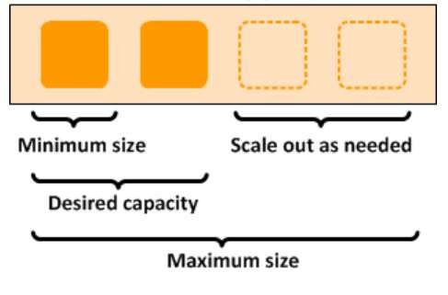
Introduction to EC2
For example, the following Auto Scaling group has a minimum size of 1 instance, a desired capacity of 2 instances, and a maximum size of 4 instances. The scaling policies that you define adjust the number of instances, within your minimum and maximum number of instances, based on the criteria that you specify.
Auto Scaling Group
30

Slide 31
Introduction to EC2
Auto Scaling Components
Groups
Your EC2 instances are organized in to groups so that they can be treated as a logical unit for the purposes of scaling and management.
When you create a group, you can specify its minimum, maximum, and, desired number of EC2 instances.
Launch Configuration
Your group uses a launch configuration as a template for its EC2 instances.
When you create a launch configuration, you can specify information such as the AMI ID, instance
type, key pair, security groups, and block device mapping for your instances.
Scaling Options
Amazon EC2 Auto Scaling provides several ways for you to scale your Auto Scaling groups.
You can configure a group to scale based on the occurrence of specified conditions (dynamic
scaling) or on a schedule.
31

Slide 32
Introduction to EC2
Auto Scaling Benefits
Setup Scaling Quickly:
AWS Auto Scaling lets you set target utilization levels for multiple resources in a single, intuitive interface.
You can quickly see the average utilization of all of your scalable resources without having to navigate to other consoles.
For example, if your application uses Amazon EC2 and Amazon Dynamo DB, you can use AWS Auto Scaling to manage resource provisioning for all of the EC2 Auto Scaling groups and database tables in your application.
Make Smart Scaling Decisions:
AWS Auto Scaling lets you build scaling plans that automate how groups of different resources respond to changes in demand.
You can optimize availability, costs, or a balance of both. AWS Auto Scaling automatically creates all of the scaling policies and sets targets for you based on your preference.
AWS Auto Scaling monitors your application and automatically adds or removes capacity from your resource groups in real-time as demands change.
32

Slide 33
Introduction to EC2
Auto Scaling Benefits
Automatically Maintain Performance
Using AWS Auto Scaling, you maintain optimal application performance and availability, even when workloads are periodic, unpredictable, or continuously changing.
AWS Auto Scaling continually monitors your applications to make sure that they are operating at
your desired performance levels.
When demand spikes, AWS Auto Scaling automatically increases the capacity of constrained resources so you maintain a high quality of service.
Pay Only For What You Need
AWS Auto Scaling can help you optimize your utilization and cost efficiencies when consuming AWS services so you only pay for the resources you actually need.
When demand drops, AWS Auto Scaling will automatically remove any excess resource capacity so you avoid overspending.
AWS Auto Scaling is free to use, and allows you to optimize the costs of your AWS environment.

Slide 34
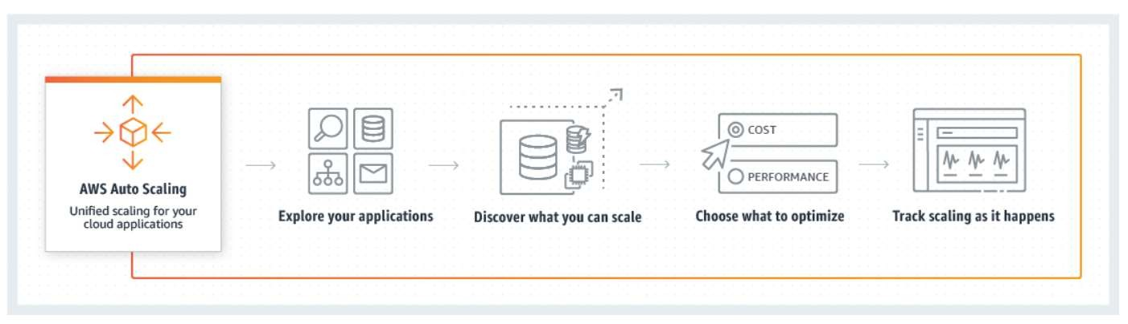
Introduction to EC2
How Auto Scaling works?

Slide 35
Introduction to EC2
Amazon Machine Images

Slide 36
Introduction to EC2
Amazon Machine Images (AMI)
An Amazon Machine Image (AMI) provides the information required to launch an instance, which is a virtual server in the cloud.
You must specify a source AMI when you launch an instance.
You can launch multiple instances from a single AMI when you need multiple instances with the same configuration. You can use different AMIs to launch instances when you need instances with different configurations.
An AMI includes the following:
A template for the root volume for the instance (for example, an operating system, an application
server, and applications).
Launch permissions that control which AWS accounts can use the AMI to launch instances.
A block device mapping that specifies the volumes to attach to the instance when it's launched.
36

Slide 37
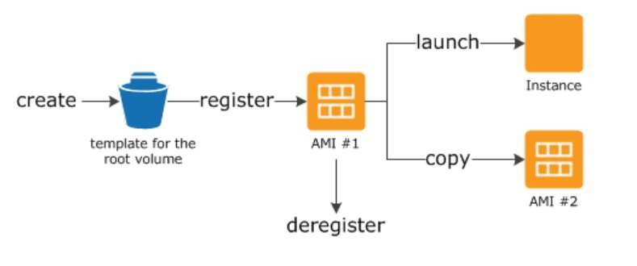
Introduction to EC2
Using an AMI
The following diagram summarizes the AMI lifecycle.
After you create and register an AMI, you can use it to launch new instances. (You can also launch instances from an AMI if the AMI owner grants you launch permissions.)
You can copy an AMI within the same region or to different regions. When you no longer
require an AMI, you can deregister it.
When you are connected to an instance, you can use it just like you use any other server.
37

Slide 38
Introduction to EC2
Creating Your Own AMI
You can launch an instance from an existing AMI, customize the instance, and then save this updated configuration as a custom AMI.
Instances launched from this new custom AMI include the customizations that you made when you created the AMI.
The root storage device of the instance determines the process you follow to create an AMI.
The root volume of an instance is either an Amazon EBS volume or an instance store volume.

Slide 39
Introduction to EC2
Launch EC2 Instance

Slide 40
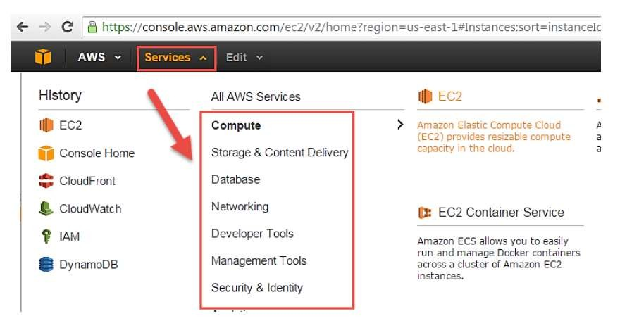
Introduction to EC2
Login and access to AWS services
Step 1) In this step,
Login to your AWS account and go to the AWS Services tab at the top left corner.
Here, you will see all of the AWS Services categorized as per their area viz. Compute, Storage, Database, etc. For creating an EC2 instance, we have to choose Compute EC2 as in the next step.
Open all the services and click on EC2
under Compute services. This will launch the dashboard of EC2.

Slide 41
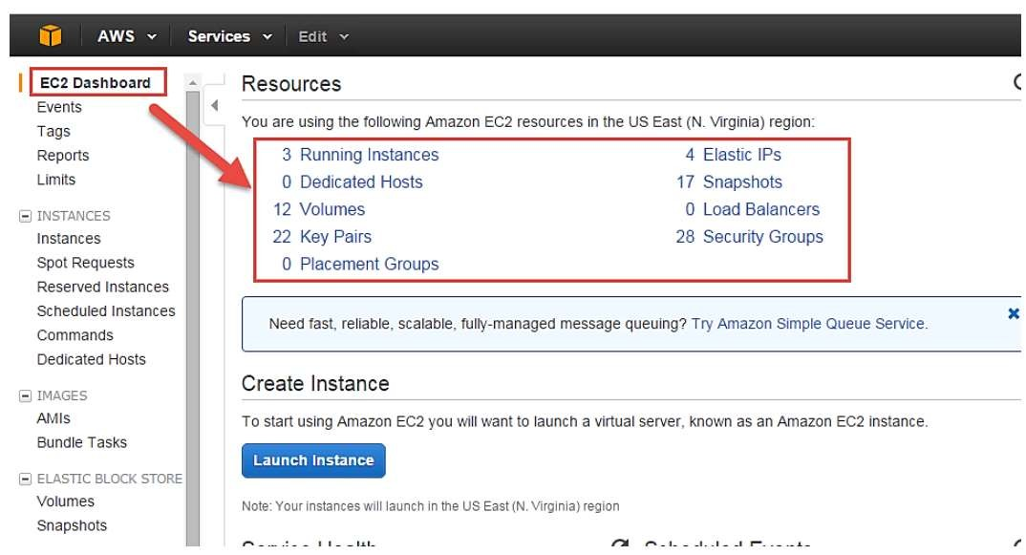
Introduction to EC2
Here is the EC2 dashboard. Here you will get all the information in gist about the AWS EC2 resources
running.

Slide 42
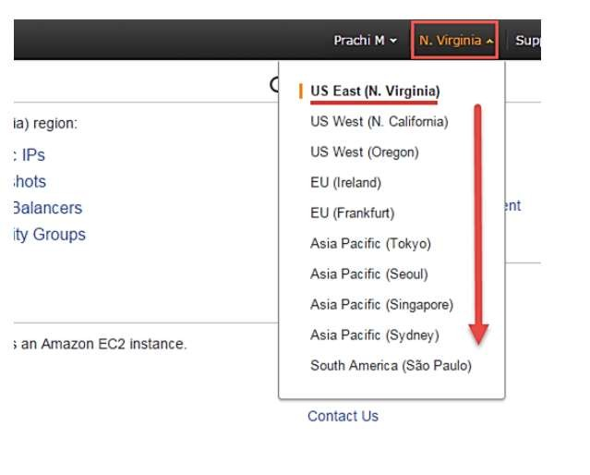
Introduction to EC2
Step 2) On the top right corner of the EC2 dashboard, choose the AWS Region in which you want to provision the EC2 server.
Here we are selecting N. Virginia.
AWS provides 10 Regions all over the globe.

Slide 43
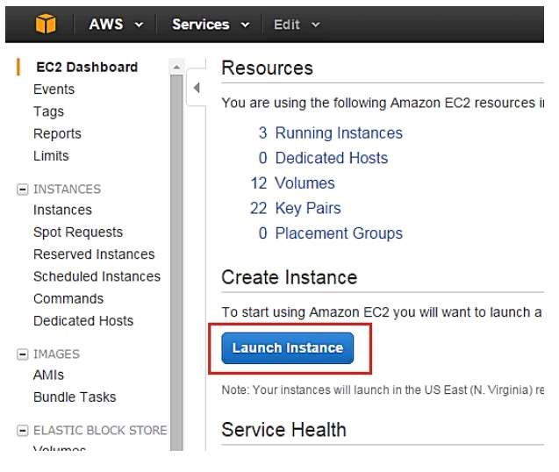
Introduction to EC2
Step 3) In this step
Once your desired Region is selected, come back to the EC2 Dashboard.
Click on 'Launch Instance' button in the section of Create Instance (as shown below).
Instance creation wizard page will open as soon as you click 'Launch Instance'.

Slide 44
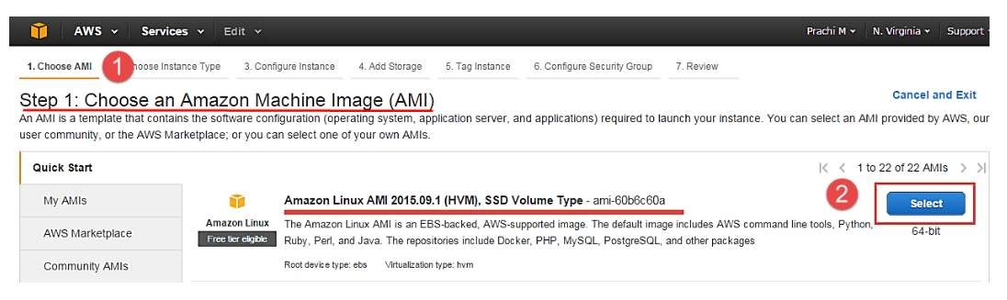
Introduction to EC2
Choose AMI
Step 1) In this step,
You will be asked to choose an AMI of your choice. (An AMI is an Amazon Machine Image. It is a template basically of an Operating System platform which you can use as a base to create your instance). Once you launch an EC2 instance from your preferred AMI, the instance will automatically be booted with the desired OS. (We will see more about AMIs in the coming part of the tutorial).
Here we are choosing the default Amazon Linux (64 bit) AMI.

Slide 45
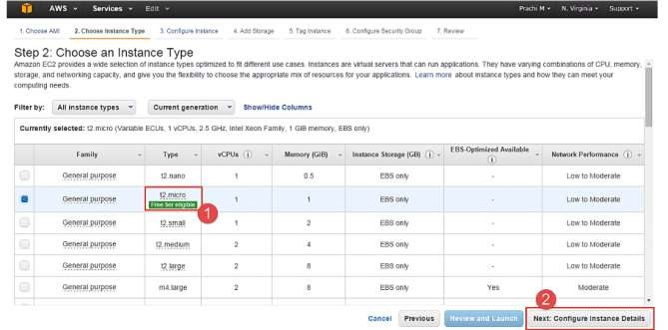
Introduction to EC2
Choose EC2 Instance Types
Step 1) In the next step, you have to choose the type of instance you require based on your business needs.
We will choose t2.micro instance type, which is a 1vCPU and 1GB memory server offered by AWS.
Click on "Configure Instance Details" for further configurations.
In the next step of the wizard, enter details like no. of instances you want to launch at a time.
Here we are launching one instance.

Slide 46
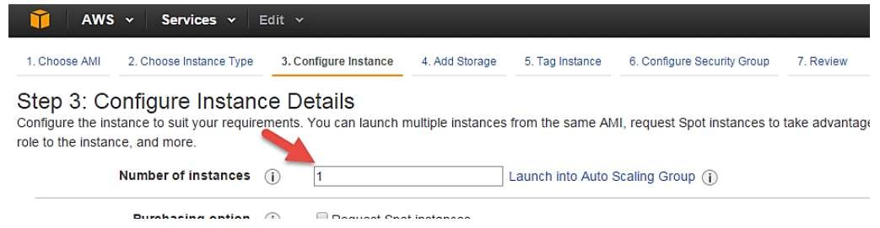
Introduction to EC2
Configure Instance
Step 1) No. of instances- you can provision up to 20 instances at a time. Here, we are launching one instance.

Slide 47
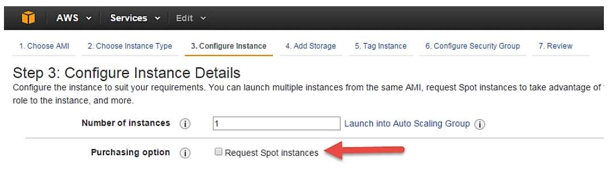
Introduction to EC2
Step 2) Under Purchasing Options, keep the option of 'Request Spot Instances' unchecked as of now.

Slide 48
Introduction to EC2
Step 3) Next, we have to configure some basic networking details for our EC2 server.
You have to decide here, in which VPC (Virtual Private Cloud) you want to launch your instance and under which subnets inside your VPC. It is better to determine and plan this prior to launching the
instance. Your AWS architecture set-up should include IP ranges for your subnets etc. pre-planned for better management.
Subnetting should also be pre-planned. E.g.: If it's a web server you should place it in the public subnet and if it's a DB server, you should place it in a private subnet all inside your VPC.
Image on the next slide,
Network section will give a list of VPCs available in our platform.
Select an already existing VPC.
You can also create a new VPC.
Here, I have selected an already existing VPC where I want to launch my instance.
48

Slide 49
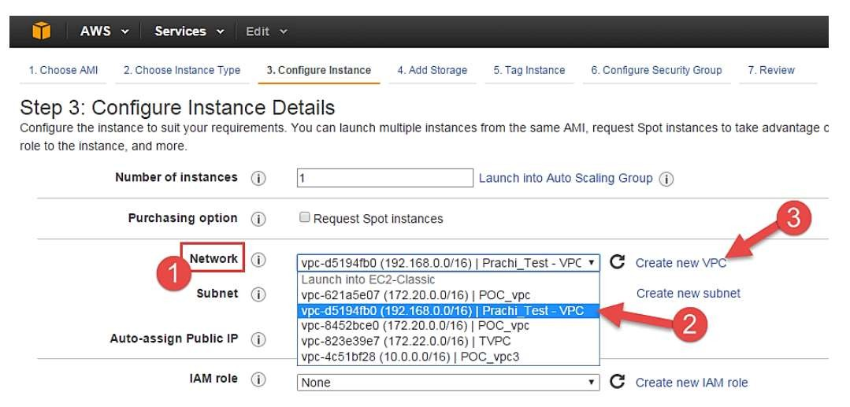
Introduction to EC2

Slide 50
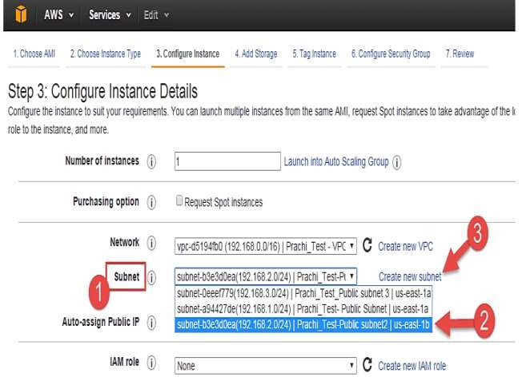
Introduction to EC2
Step 4) In this step, A VPC consists of subnets, which are IP ranges that are separated for restricting access.
Under Subnets, you can choose the subnet where you want to place your instance.
I have chosen an already existing public subnet.
You can also create a new subnet in this step.
Once your instance is launched in a public subnet, AWS will assign a dynamic public IP to it from their pool of IPs.

Slide 51
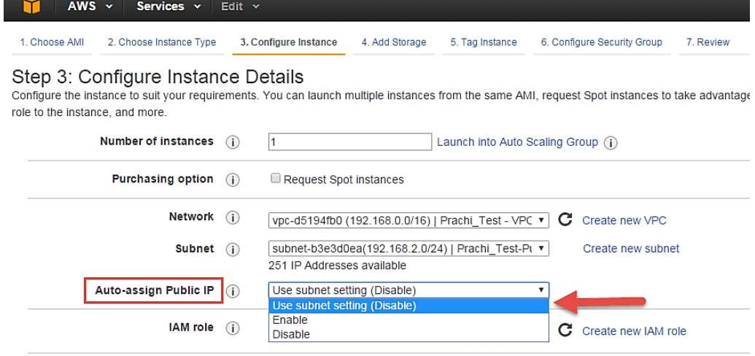
Introduction to EC2
Step 5) In this step,
You can choose if you want AWS to assign it an IP automatically, or you want to do it manually later.
You can enable/ disable 'Auto assign Public IP' feature here likewise.
Here we are going to assign this instance a static IP called as EIP (Elastic IP) later. So we keep this feature disabled as of now.

Slide 52
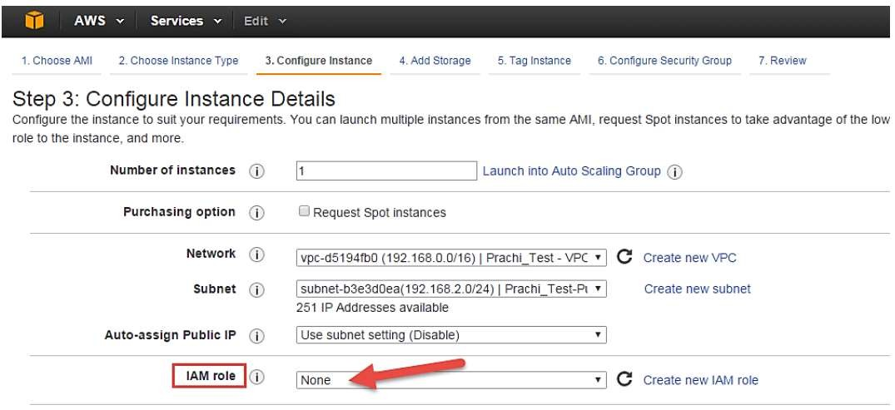
Introduction to EC2
Step 6) In this step, In the following step, keep the option of IAM role 'None' as of now. We will visit the
topic of IAM role in detail in IAM services.

Slide 53
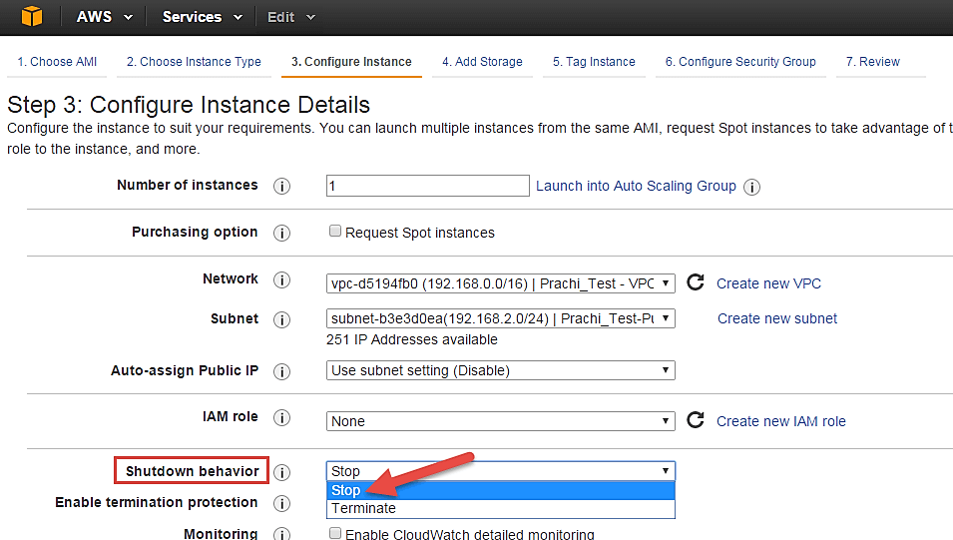
Introduction to EC2
Step 7) In this step, you have to do following things Shutdown Behavior – when you accidently shut down your instance, you surely don't want it to be deleted but stopped. Here we are defining my shutdown behaviour as Stop.

Slide 54
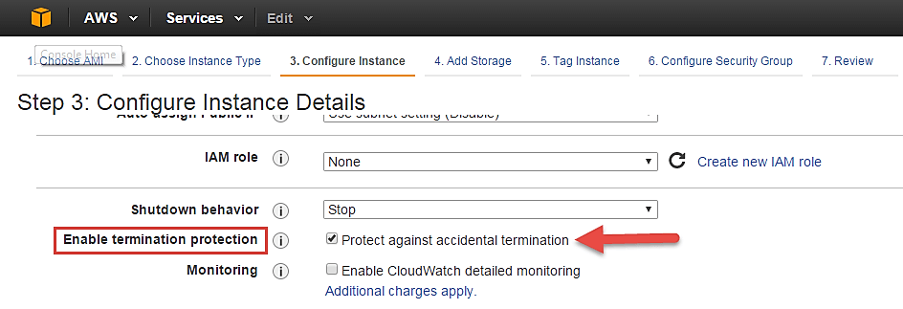
Introduction to EC2
Step 8) In this step, In case, you have accidently terminated your instance, AWS has a layer of security mechanism. It will not delete your instance if you have enabled accidental termination protection. Here we are checking the option for further protecting our instance from accidental termination.

Slide 55
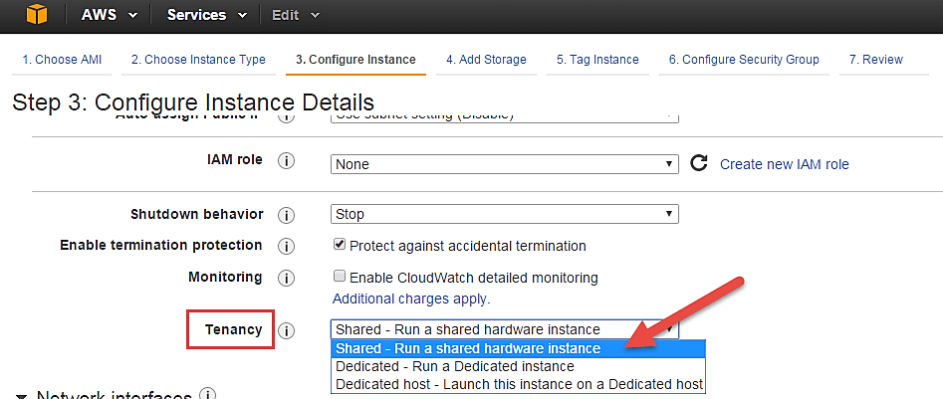
Introduction to EC2
Step 9) In this step, Under Monitoring- you can enable Detailed Monitoring if your instance is a business critical instance. Here, we have kept the option unchecked. AWS will always provide Basic monitoring on your instance free of cost. We will visit the topic of monitoring in AWS Cloud Watch part of the tutorial.
Under Tenancy- select the option if shared tenancy. If your application is a highly secure application, then you should go for dedicated capacity. AWS provides both options.

Slide 56
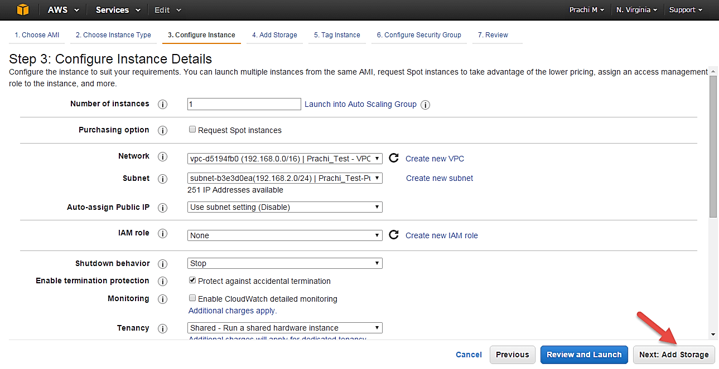
Introduction to EC2
Step 10) In this step, Click on 'Add Storage' to add data volumes to your instance in next step.

Slide 57
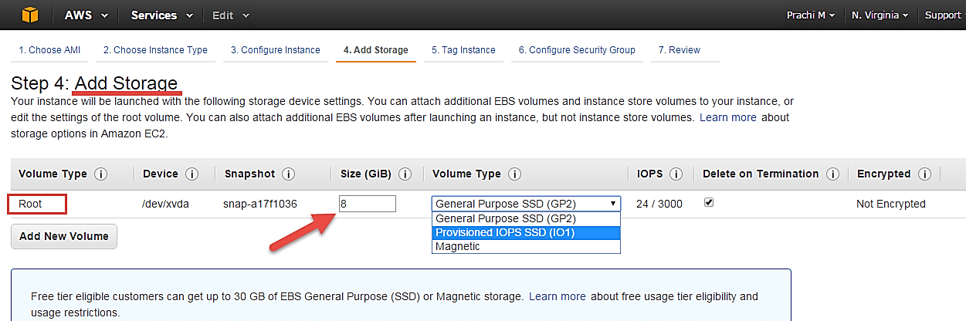
Introduction to EC2
Add Storage
Step 1) In this step we do following things, In the Add Storage step, you'll see that the instance has been automatically provisioned a General Purpose SSD root volume of 8GB. ( Maximum volume size we can give to a General Purpose volume is 16GB)
You can change your volume size, add new volumes, change the volume type, etc.
AWS provides 3 types of EBS volumes- Magnetic, General Purpose SSD, Provisioned IOPs. You can choose a volume type based on your application's IOPs needs.

Slide 58
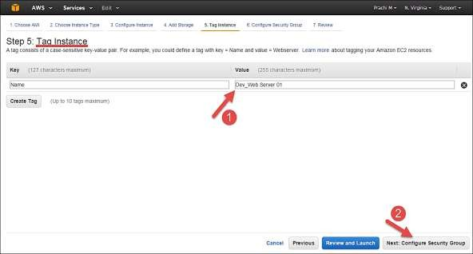
Introduction to EC2
Tag Instance
Step 1) In this step, you can tag your instance with a key-value pair. This gives visibility to the AWS account administrator when there are lot number of instances.
The instances should be tagged based on their department, environment like Dev/SIT/Prod. Etc. this gives a clear view of the costing on the instances under one common tag.
Here we have tagged the instance as a Dev Web server 01.
Go to configure Security Groups later.

Slide 59
Introduction to EC2
Configure Security Groups
Step 1) In this next step of configuring Security Groups, you can restrict traffic on your instance ports. This is an added firewall mechanism provided by AWS apart from your instance's OS firewall.
You can define open ports and IPs.
Since our server is a webserver, we will do following things:
Creating a new Security Group
Naming our SG for easier reference
Defining protocols which we want enabled on my instance
Assigning IPs which are allowed to access our instance on the said protocols
Once, the firewall rules are set- Review and launch

Slide 60
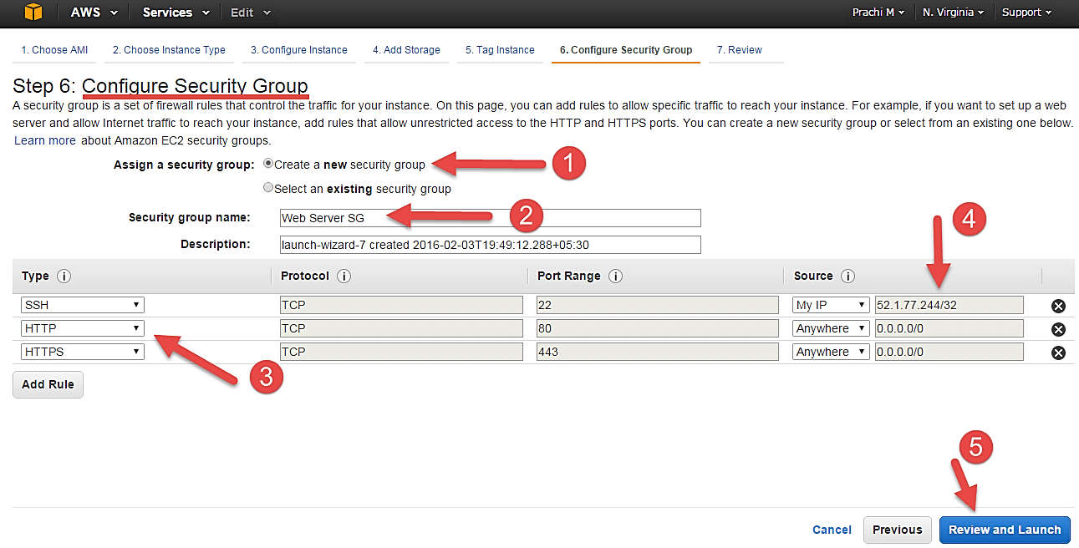
Introduction to EC2

Slide 61
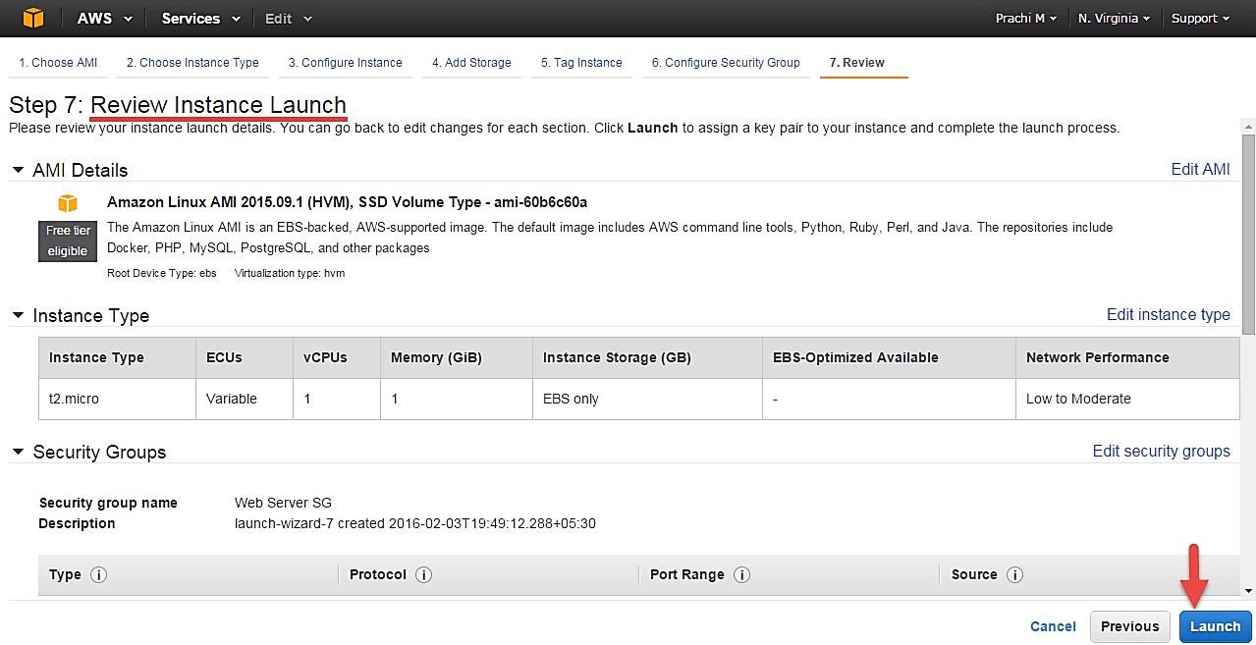
Introduction to EC2
Review Instances
Step 1) In this step, we will review all our choices and parameters and go ahead to launch our instance.

Slide 62
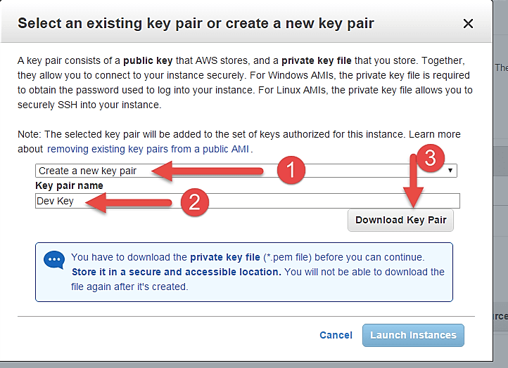
Introduction to EC2
Step 2) In the next step, you will be asked to create a key pair to login to you an instance. A key pair is a set of public-private keys. AWS stores the private key in the instance, and you are asked to download the public key. Make sure you download the key and keep it safe and secured; if it is lost you cannot download it again.
Create a new key pair
Give a name to your key
Download and save it in your secured folder

Slide 63

Introduction to EC2
When you download your key, you can open and have a look at your RSA private key.

Slide 64
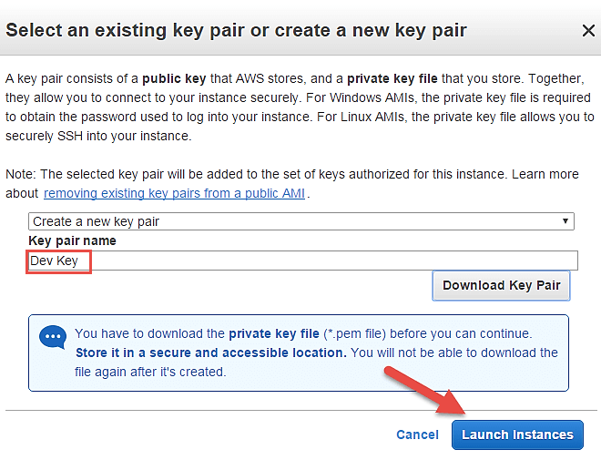
Introduction to EC2
Once you are done downloading and saving your key, launch your instance.

Slide 65
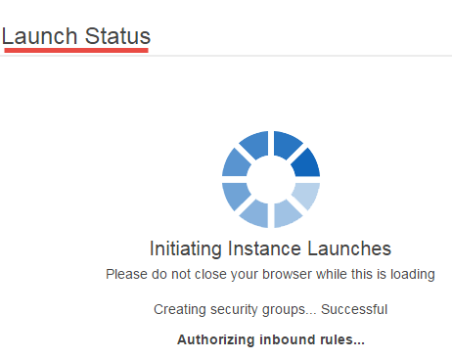
Introduction to EC2
You can see the launch status meanwhile.

Slide 66
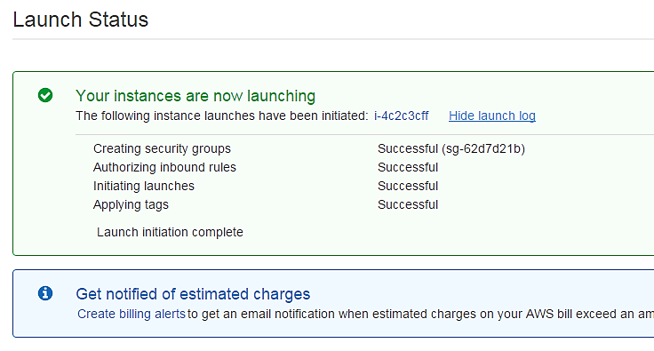
Introduction to EC2
You can also see the launch log.

Slide 67
Introduction to EC2
Converting your Instance Store-Backed AMI to an Amazon EBS-Backed AMI

Slide 68
Introduction to EC2
You can convert an instance store-backed Linux AMI that you own to an Amazon EBS-backed Linux AMI.
You can't convert an instance store-backed Windows AMI to an Amazon EBS-backed Windows AMI and you cannot convert an AMI that you do not own.
To convert an instance store-backed AMI to an Amazon EBS-backed AMI:
Launch an Amazon Linux instance from an Amazon EBS-backed AMI.
Amazon Linux instances have the AWS CLI and AMI tools pre-installed.

Slide 69

Introduction to EC2
Upload the X.509 private key that you used to bundle your instance store-backed AMI to your instance. We use this key to ensure that only you and Amazon EC2 can access your AMI.
1. Create a temporary directory on your instance for your X.509 private key as follows: mkdir /tmp/cert
2. Copy your X.509 private key from your computer to the /tmp/cert directory on your instance, using a secure copy tool such as scp. The my-private-key parameter in the following command is the private key you use to connect to your instance with SSH. For example:
scp -i my-private-key.pem /path/to/pk-HKZYKTAIG2ECMXYIBH3HXV4ZBEXAMPLE.pem ec2-user@ec2-203-0-113-25.compute-1.amazonaws.com:/tmp/cert/
pk-HKZYKTAIG2ECMXYIBH3HXV4ZBEXAMPLE.pem 100% 717 0.7KB/s 00:00

Slide 70
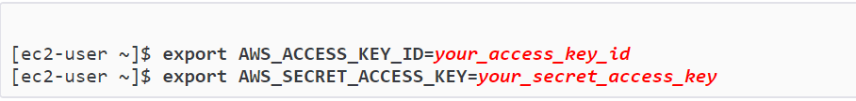
Introduction to EC2
3. Set environment variables for your AWS access key and secret key. export AWS_ACCESS_KEY_ID=your_access_key_id
export AWS_SECRET_ACCESS_KEY=your_secret_access_key
Prepare an Amazon EBS volume for your new AMI.
a. Create an empty Amazon EBS volume in the same Availability Zone as your instance using the create-volume command. Note the volume ID in the command output.
This Amazon EBS volume must be the same size or larger than the original instance store root volume.

Slide 71
Introduction to EC2
a. aws ec2 create-volume --size 10 --region us-west-2 --availability-zone us-west-2z
b. Attach the volume to your Amazon EBS-backed instance using the attach-volume command.
aws ec2 attach-volume --volume-id volume_id --instance-id instance_id --device /dev/sdb --region us- west-2

Slide 72

Introduction to EC2
5. Create a folder for your bundle. mkdir /tmp/bundle
6. Download the bundle for your instance store-based AMI to /tmp/bundle using the ec2-download-bundle command.
ec2-download-bundle -b my-s3-bucket/bundle_folder/bundle_name -m image.manifest.xml -a
$AWS_ACCESS_KEY_ID -s $AWS_SECRET_ACCESS_KEY --privatekey /path/to/pk- HKZYKTAIG2ECMXYIBH3HXV4ZBEXAMPLE.pem -d /tmp/bundle

Slide 73

Introduction to EC2
Reconstitute the image file from the bundle using the ec2-unbundle command.
a. Change directories to the bundle folder. cd /tmp/bundle/
b. Run the ec2-unbundle command.
ec2-unbundle -m image.manifest.xml --privatekey /path/to/pk- HKZYKTAIG2ECMXYIBH3HXV4ZBEXAMPLE.pem

Slide 74
Introduction to EC2
8. Copy the files from the unbundled image to the new Amazon EBS volume. sudo dd if=/tmp/bundle/image of=/dev/sdb bs=1M
9. Probe the volume for any new partitions that were unbundled. sudo partprobe /dev/sdb1

Slide 75
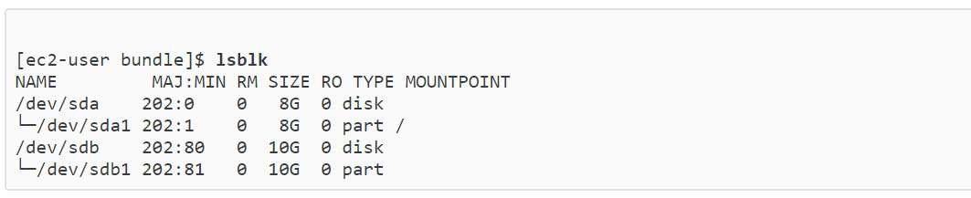
Introduction to EC2
10. List the block devices to find the device name to mount. lsblk
NAME MAJ:MIN RM SIZE RO TYPE MOUNTPOINT
/dev/sda 202:0 0 8G 0 disk
└─/dev/sda1 202:1 0 8G 0 part /
/dev/sdb 202:80 0 10G 0 disk
└─/dev/sdb1 202:81 0 10G 0 part
In this example, the partition to mount is /dev/sdb1, but your device name will likely be different. If your volume is not partitioned, then the device to mount will be similar to /dev/sdb (without a device partition trailing digit).
75

Slide 76
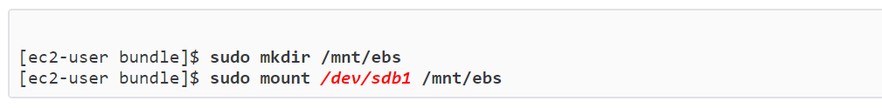
Introduction to EC2
11. Create a mount point for the new Amazon EBS volume and mount the volume.
sudo mkdir /mnt/ebs
[ec2-user bundle]$ sudo mount /dev/sdb1 /mnt/ebs
12. Open the /etc/fstab file on the EBS volume with your favourite text editor (such as vim or nano) and remove any entries for instance store (ephemeral) volumes. Because the Amazon EBS volume is mounted on /mnt/ebs, the fstab file is located at /mnt/ebs/etc/fstab.
sudo nano /mnt/ebs/etc/fstab
#
LABEL=/ /
ext4 defaults,noatime 1 1
tmpfs defaults 0 0
tmpfs devpts sysfs proc
/dev/sdb
/dev/shm
/dev/pts
devpts gid=5,mode=620 0
0
/sys
/proc
sysfs
proc
defaults 0 0
defaults 0 0 auto
/media/ephemeral0
defaults,comment=cloudconfig 0 2
76

Slide 77
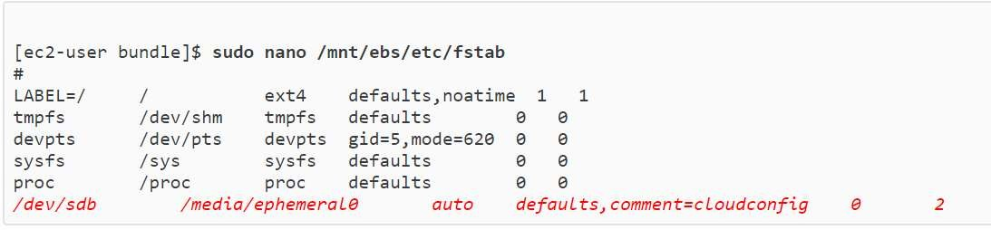
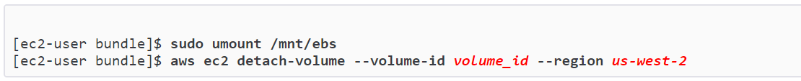
Introduction to EC2
13. Unmount the volume and detach it from the instance. sudo umount /mnt/ebs
aws ec2 detach-volume --volume-id volume_id --region us-west-2

Slide 78
Introduction to EC2
Create an AMI from the new Amazon EBS volume as follows:
a. Create a snapshot of the new Amazon EBS volume.
aws ec2 create-snapshot --region us-west-2 --description "your_snapshot_description" --volume-id volume_id
b. Check to see that your snapshot is complete.
aws ec2 describe-snapshots --region us-west-2 --snapshot-id snapshot_id

Slide 79
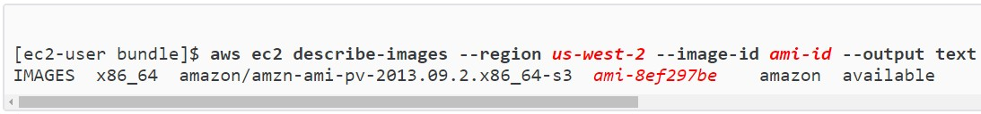
Introduction to EC2
c. Identify the processor architecture, virtualization type, and the kernel image (aki) used on the original AMI with the describe-images command. You need the AMI ID of the original instance store-backed AMI for this step.
aws ec2 describe-images --region us-west-2 --image-id ami-id --output text
IMAGES x86_64 amazon/amzn-ami-pv-2013.09.2.x86_64-s3 ami-8ef297be amazon
available public machine aki-fc8f11cc instance-store paravirtual xen
In this example, the architecture is x86_64 and the kernel image ID is aki-fc8f11cc. Use these values in the following step. If the output of the above command also lists an ari ID, take note of that as well.

Slide 80

Introduction to EC2
d. Register your new AMI with the snapshot ID of your new Amazon EBS volume and the values from the previous step. If the previous command output listed an ari ID, include that in the following command with --ramdisk-id ari_id.
aws ec2 register-image --region us-west-2 --name your_new_ami_name --block-device-mappings DeviceName=device-name,Ebs={SnapshotId=snapshot_id} --virtualization-type paravirtual --architecture x86_64 --kernel-id aki-fc8f11cc --root-device-name device-name.
15.(Optional) After you have tested that you can launch an instance from your new AMI, you can delete the Amazon EBS volume that you created for this procedure.
aws ec2 delete-volume --volume-id volume_id

Slide 81
Introduction to EC2
Elastic Block Store

Slide 82
Introduction to EC2
Amazon Elastic Block Store (Amazon EBS)
Amazon Elastic Block Store (Amazon EBS) provides block level storage volumes for use with EC2 instances.
EBS volumes are highly available and reliable storage volumes that can be attached to any running
instance that is in the same Availability Zone.
EBS volumes that are attached to an EC2 instance are exposed as storage volumes that persist independently from the life of the instance.
With Amazon EBS, you pay only for what you use.
Amazon EBS is recommended when data must be quickly accessible and requires long-term persistence.
EBS volumes are particularly well-suited for use as the primary storage for file systems, databases, or for any applications that require fine granular updates and access to raw, unformatted, block- level storage.

Slide 83
Introduction to EC2
Amazon Elastic Block Store (Amazon EBS)
Amazon EBS is well suited to both database-style applications that rely on random reads and writes, and to throughput-intensive applications that perform long, continuous reads and writes.
Amazon EBS encryption offers you a simple encryption solution for your EBS volumes without the need for you to build, manage, and secure your own key management infrastructure.
When you create an encrypted EBS volume and attach it to a supported instance type, data stored at
rest on the volume, disk I/O, and snapshots created from the volume are all encrypted.
The encryption occurs on the servers that hosts EC2 instances, providing encryption of data-in-transit
from EC2 instances to EBS storage.

Slide 84
Introduction to EC2
Amazon Elastic Block Store (Amazon EBS)
Amazon EBS encryption uses AWS Key Management Service (AWS KMS) master keys when creating encrypted volumes and any snapshots created from your encrypted volumes.
The first time you create an encrypted EBS volume in a region, a default master key is created for you
automatically.
This key is used for Amazon EBS encryption unless you select a Customer Master Key (CMK) that
you created separately using the AWS Key Management Service.
Creating your own CMK gives you greater flexibility when defining access controls, including the ability to create, rotate, disable, and audit encryption keys that are specific to individual applications and users.

Slide 85
Introduction to EC2
Amazon Elastic Block - Features
You can create EBS General Purpose SSD (gp2), Provisioned IOPS SSD (io1), Throughput Optimized HDD (st1), and Cold HDD (sc1) volumes up to 16 TiB in size. You can mount these volumes as devices on your Amazon EC2 instances. You can mount multiple volumes on the same instance, but each volume can be attached to only one instance at a time. You can dynamically change the configuration of a volume attached to an instance.
With General Purpose SSD (gp2) volumes, you can expect base performance of 3 IOPS/GiB, with the ability to burst to 3,000 IOPS for extended periods of time. Gp2 volumes are ideal for a broad range of use cases such as boot volumes, small and medium-size databases, and development and test environments. Gp2 volumes support up to 10,000 IOPS and 160 MB/s of throughput.
With Provisioned IOPS SSD (io1) volumes, you can provision a specific level of I/O performance. Io1 volumes support up to 32,000 IOPS and 500 MB/s of throughput. This allows you to predictably scale to tens of thousands of IOPS per EC2 instance.
Throughput Optimized HDD (st1) volumes provide low-cost magnetic storage that defines performance in terms of throughput rather than IOPS. With throughput of up to 500 MiB/s, this volume type is a good fit for large, sequential workloads such as Amazon EMR, ETL, data warehouses, and log processing.

Slide 86
Introduction to EC2
Amazon Elastic Block - Features
Cold HDD (sc1) volumes provide low-cost magnetic storage that defines performance in terms of throughput rather than IOPS. With throughput of up to 250 MiB/s, sc1 is a good fit ideal for large, sequential, cold-data workloads. If you require infrequent access to your data and are looking to save costs, sc1 provides inexpensive block storage.
EBS volumes behave like raw, unformatted block devices. You can create a file system on top of these volumes, or use them in any other way you would use a block device (like a hard drive).
You can use encrypted EBS volumes to meet a wide range of data-at-rest encryption requirements for regulated/audited data and applications.
You can create point-in-time snapshots of EBS volumes, which are persisted to Amazon S3. Snapshots protect data for long-term durability, and they can be used as the starting point for new EBS volumes. The same snapshot can be used to instantiate as many volumes as you wish. These snapshots can be copied across AWS regions.

Slide 87
Introduction to EC2
Amazon Elastic Block - Features
EBS volumes are created in a specific Availability Zone, and can then be attached to any instances in that same Availability Zone. To make a volume available outside of the Availability Zone, you can create a snapshot and restore that snapshot to a new volume anywhere in that region. You can copy snapshots to other regions and then restore them to new volumes there, making it easier to leverage multiple AWS regions for geographical expansion, data center migration, and disaster recovery.
A large repository of public data set snapshots can be restored to EBS volumes and seamlessly integrated into AWS cloud-based applications.
Performance metrics, such as bandwidth, throughput, latency, and average queue length, are available through the AWS Management Console. These metrics, provided by Amazon CloudWatch, allow you to monitor the performance of your volumes to make sure that you are providing enough performance for your applications without paying for resources you don't need.

Slide 88
Introduction to EC2
Benefits of Amazon Elastic Block Store (Amazon EBS)
Reliable, Secure Storage
Consistent, Low-latency Performance
Quickly Scale Up, Easily Scale Down
Optimized Performance

Slide 89
Introduction to EC2
Elastic IP Address

Slide 90
Introduction to EC2
Elastic IP Addresses
An Elastic IP address is a static IPv4 address designed for dynamic cloud computing.
An Elastic IP address is associated with your AWS account.
With an Elastic IP address, you can mask the failure of an instance or software by rapidly remapping the address to another instance in your account.
An Elastic IP address is a public IPv4 address, which is reachable from the internet.
If your instance does not have a public IPv4 address, you can associate an Elastic IP address with
your instance to enable communication with the internet; for example, to connect to your instance from your local computer.

Slide 91
Introduction to EC2
The following are the basic characteristics of an Elastic IP address:
To use an Elastic IP address, you first allocate one to your account, and then associate it with your instance or a network interface.
When you associate an Elastic IP address with an instance or its primary network interface, the instance's public IPv4 address (if it had one) is released back into Amazon's pool of public IPv4 addresses. You cannot reuse a public IPv4 address.
You can disassociate an Elastic IP address from a resource, and re-associate it with a different
resource. Any open connections to an instance continue to work for a time even after you disassociate its Elastic IP address and re-associate it with another instance.
A disassociated Elastic IP address remains allocated to your account until you explicitly release it.

Slide 92
Introduction to EC2
The following are the basic characteristics of an Elastic IP address:
To ensure efficient use of Elastic IP addresses, we impose a small hourly charge if an Elastic IP address is not associated with a running instance, or if it is associated with a stopped instance or an unattached network interface. While your instance is running, you are not charged for one Elastic IP address associated with the instance, but you are charged for any additional Elastic IP addresses associated with the instance.
An Elastic IP address is for use in a specific region only.
When you associate an Elastic IP address with an instance that previously had a public IPv4 address, the public DNS hostname of the instance changes to match the Elastic IP address.
We resolve a public DNS hostname to the public IPv4 address or the Elastic IP address of the instance
outside the network of the instance, and to the private IPv4 address of the instance from within the
network of the instance.
92

Slide 93
Introduction to EC2
The following are the basic characteristics of an Elastic IP address:
Allocating an Elastic IP Address
Describing Your Elastic IP Addresses
Tagging an Elastic IP Address
Associating an Elastic IP Address with a Running Instance
Disassociating an Elastic IP Address and Re-associating with a Different Instance
Moving an Elastic IP Address
Releasing an Elastic IP Address
Recovering an Elastic IP Address

Slide 94
Introduction to EC2
Amazon Route 53

Slide 95
Introduction to EC2
Amazon Route 53
Amazon Route 53 is a highly available and scalable cloud Domain Name System (DNS) web service.
It is designed to give developers and businesses an extremely reliable and cost effective way to route end users to Internet applications by translating names like www.example.com into the numeric IP addresses like 192.0.2.1 that computers use to connect to each other.
Amazon Route 53 is fully compliant with IPv6 as well.
Amazon Route 53 effectively connects user requests to infrastructure running in AWS – such as Amazon EC2 instances, Elastic Load Balancing load balancers, or Amazon S3 buckets – and can also be used to route users to infrastructure outside of AWS.
You can use Amazon Route 53 to configure DNS health checks to route traffic to healthy endpoints or to independently monitor the health of your application and its endpoints.

Slide 96
Introduction to EC2
Amazon Route 53
Amazon Route 53 Traffic Flow makes it easy for you to manage traffic globally through a variety of routing types, including Latency Based Routing, Geo DNS, Geo-proximity, and Weighted Round Robin—all of which can be combined with DNS Failover in order to enable a variety of low-latency, fault-tolerant architectures.
Using Amazon Route 53 Traffic Flow’s simple visual editor, you can easily manage how your end- users are routed to your application’s endpoints—whether in a single AWS region or distributed around the globe.
Amazon Route 53 also offers Domain Name Registration – you can purchase and manage domain names such as example.com and Amazon Route 53 will automatically configure DNS settings for your domains.
Amazon Route 53 is designed to be fast, easy to use, and cost-effective.
It answers DNS queries with low latency by using a global network of DNS servers.
Queries for your domain are automatically routed to the nearest DNS server, and thus answered with the best possible performance.

Slide 97
Introduction to EC2
Amazon Route 53
With Amazon Route 53, you can create and manage your public DNS records with the AWS Management Console or with an easy-to-use API.
If you need a domain name, you can find an available name and register it using Amazon Route 53.
You can also transfer existing domains into Amazon Route 53’s management.
It’s also integrated with other Amazon Web Services.
For instance, by using the AWS Identity and Access Management (IAM) service with Amazon Route
53, you can control who in your organization can make changes to your DNS records.
Like other Amazon Web Services, there are no long-term contracts or minimum usage requirements for using Amazon Route 53 – you pay only for managing domains through the service, for the number of queries that the service answers, and for the domain names that you have registered through Amazon Route 53.
97

Slide 98
Introduction to EC2
Amazon Route 53 - Features
Traffic Flow: Easy-to-use and cost-effective global traffic management: route end users to the best endpoint for your application based on geo-proximity , latency, health, and other considerations.
Latency Based Routing: Route end users to the AWS region that provides the lowest possible latency.
Geo DNS: Route end users to a particular endpoint that you specify based on the end user’s geographic location.
Private DNS for Amazon VPC: Manage custom domain names for your internal AWS resources without exposing DNS data to the public Internet.
DNS Failover: Automatically route your website visitors to an alternate location to avoid site outages.
Health Checks and Monitoring: Amazon Route 53 can monitor the health and performance of your
application as well as your web servers and other resources.
100

Slide 99
Introduction to EC2
Amazon Route 53 - Features
Domain Registration: Amazon Route 53 offers domain name registration services, where you can search for and register available domain names or transfer in existing domain names to be managed by Route 53.
Cloud Front Zone Apex Support: When using Amazon Cloud Front to deliver your website content, visitors to your website can now access your site at the zone apex (or "root domain").
S3 Zone Apex Support: Visitors to your website hosted on Amazon S3 can now access your site at the zone apex (or "root domain").
Amazon ELB Integration: Amazon Route 53 is integrated with Elastic Load Balancing (ELB).
Management Console: Amazon Route 53 works with the AWS Management Console. This web- based, point-and-click, graphical user interface lets you manage Amazon Route 53 without writing any code at all.
Weighted Round Robin: Amazon Route 53 offers Weighted Round Robin (WRR) functionality.
100

Slide 100
Introduction to EC2
DNS System
100

Slide 101
Introduction to EC2
DNS SYSTEM
All computers on the Internet, from your smart phone or laptop to the servers that serve content for massive retail websites, find and communicate with one another by using numbers.
These numbers are known as IP addresses. When you open a web browser and go to a website, you don't have to remember and enter a long number. Instead, you can enter a domain name like example.com and still end up in the right place.
A DNS service such as Amazon Route 53 is a globally distributed service that translates human readable names like www.example.com into the numeric IP addresses like 192.0.2.1 that computers use to connect to each other.
The Internet’s DNS system works much like a phone book by managing the mapping between names and numbers.
DNS servers translate requests for names into IP addresses, controlling which server an end user will reach when they type a domain name into their web browser.
These requests are called queries.
100

Slide 102
Introduction to EC2
Types of DNS Service
Authoritative DNS:
An authoritative DNS service provides an update mechanism that developers use to manage their public DNS names.
It then answers DNS queries, translating domain names into IP address so computers can communicate with each other. Authoritative DNS has the final authority over a domain and is responsible for providing answers to recursive DNS servers with the IP address information.
Amazon Route 53 is an authoritative DNS system.
Recursive DNS:
Clients typically do not make queries directly to authoritative DNS services.
Instead, they generally connect to another type of DNS service known a resolver, or a recursive
DNS service.
A recursive DNS service acts like a hotel concierge: while it doesn't own any DNS records, it acts as an intermediary who can get the DNS information on your behalf.
If a recursive DNS has the DNS reference cached, or stored for a period of time, then it answers the DNS query by providing the source or IP information.
If not, it passes the query to one or more authoritative DNS servers to find the information.
102

Slide 103
Introduction to EC2
How Does DNS Route Traffic To Your Web Application?
The diagram on the next slide gives an overview of how recursive and authoritative DNS services work together to route an end user to your website or application.
A user opens a web browser, enters www.example.com in the address bar, and presses Enter.
The request for www.example.com is routed to a DNS resolver, which is typically managed by the user's Internet service provider (ISP), such as a cable Internet provider, a DSL broadband provider, or a corporate network.
The DNS resolver for the ISP forwards the request for www.example.com to a DNS root name server.
The DNS resolver for the ISP forwards the request for www.example.com again, this time to one of the TLD name servers for .com domains.
The name server for .com domains responds to the request with the names of the four Amazon
Route 53 name servers that are associated with the example.com domain.
The DNS resolver for the ISP chooses an Amazon Route 53 name server and forwards the request for www.example.com to that name server.
103

Slide 104
Introduction to EC2
How Does DNS Route Traffic To Your Web Application?
The Amazon Route 53 name server looks in the example.com hosted zone for the www.example.com record, gets the associated value, such as the IP address for a web server, 192.0.2.44, and returns the IP address to the DNS resolver.
The DNS resolver for the ISP finally has the IP address that the user needs.
The resolver returns that value to the web browser.
The DNS resolver also caches (stores) the IP address for example.com for an amount of time that you specify so that it can respond more quickly the next time someone browses to example.com. For more information, see time to live (TTL).
The web browser sends a request for www.example.com to the IP address that it got from the DNS resolver.
This is where your content is, for example, a web server running on an Amazon EC2 instance or an Amazon S3 bucket that's configured as a website endpoint.
The web server or other resource at 192.0.2.44 returns the web page for www.example.com to the web browser, and the web browser displays the page.
103

Slide 105
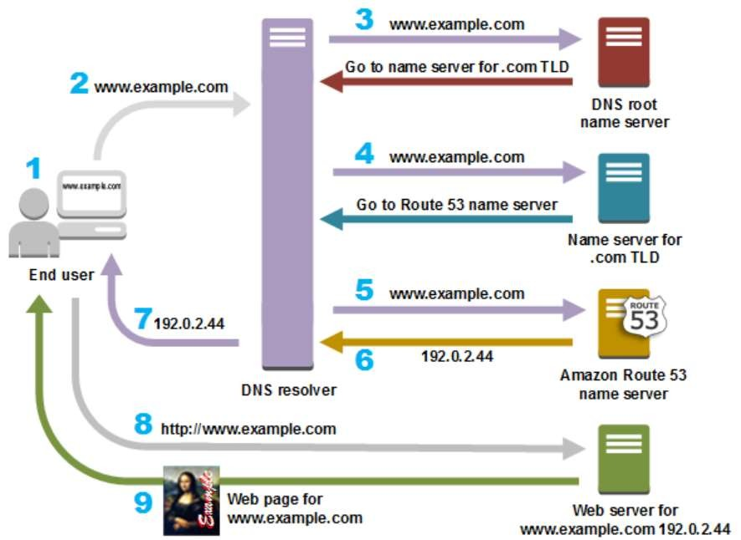
Introduction to EC2
How Does DNS Route Traffic To Your Web Application?
103

Slide 106
Introduction to EC2
CloudFront
103

Slide 107
Introduction to EC2
CloudFront
CloudFront is a CDN (Content Delivery Network).
It retrieves data from Amazon S3 bucket and distributes it to multiple datacenter locations.
It delivers the data through a network of data centres called edge locations.
The nearest edge location is routed when the user requests for data, resulting in lowest latency, low network traffic, fast access to data, etc.
Amazon CloudFront is a global content delivery network (CDN) service that securely delivers data,
videos, applications, and APIs to your viewers with low latency and high transfer speeds.
You can get started with CloudFront in minutes, using the same AWS tools that you're already familiar
with: APIs, AWS Management Console, AWS CloudFormation, CLIs, and SDKs.
CloudFront offers a simple, pay-as-you-go pricing model with no upfront fees or required long-term contracts, and support for CloudFront is included in your existing AWS Support subscription.
107

Slide 108
Introduction to EC2
Amazon CloudFront Use Cases:
Static Asset Caching:
Amazon CloudFront can speed up the delivery of your static content (e.g., images, style sheets,
JavaScript, etc.) to viewers across the globe.
CloudFront offers a multi-tier cache by default, with regional edge caches that improve latency and lower the load on your origin servers when the object is not already cached at the edge.
Caching static content gives you the performance and scale you need to give your viewers a fast
and reliable experience when visiting your website.
Live and On-Demand Video Streaming:
The Amazon CloudFront CDN offers multiple options for streaming your media – both pre- recorded files and live events – at sustained, high throughput required for 4K delivery to global viewers. For on-demand streaming, you can use CloudFront for multi-bitrate adaptive streaming in Microsoft Smooth, HLS, HDS, or MPEG-DASH formats to any device.
To broadcast a live stream, you can use CloudFront to cache the media fragments at the edge and collapse multiple requests for the manifest file to reduce load to your origin.
113

Slide 109
Introduction to EC2
Amazon CloudFront Use Cases:
Software Distribution
Amazon CloudFront scales automatically as globally-distributed clients download software updates. You can make your software available right at the edge where your users are via the content delivery network.
CloudFront’s high data transfer rates speed up the delivery of your binaries, improving customer experience while lowering your costs.
API Acceleration
Amazon CloudFront can be used to secure and accelerate your API calls. CloudFront supports proxy methods (POST, PUT, OPTIONS, DELETE, and PATCH) and is already integrated with Amazon API Gateway by default. With CloudFront, TLS connections with clients terminate at a nearby edge location, then CloudFront uses optimized AWS-backbone network paths to securely reach your API servers.
113

Slide 110
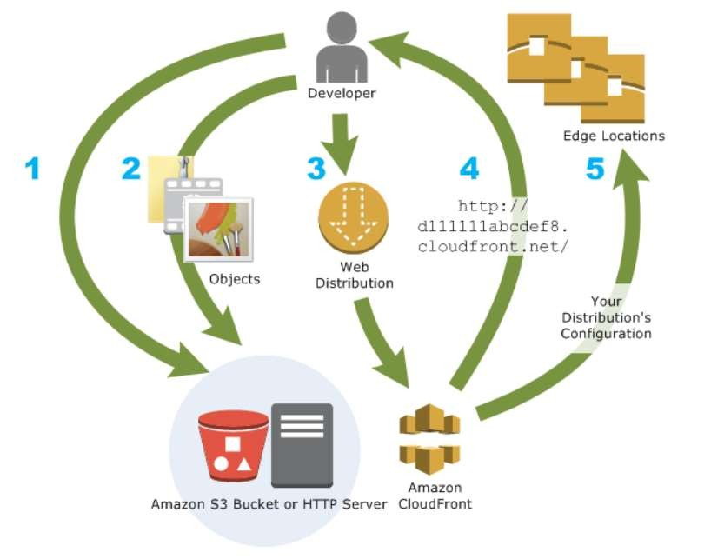
Introduction to EC2
How You Set Up CloudFront to Deliver Content?
You create a CloudFront distribution to tell CloudFront where you want content to be delivered from, and the details about how to track and manage content delivery. Then CloudFront uses computers — edge servers
— that are close to your viewers to deliver that content quickly when someone wants to see it or use it.
113

Slide 111
Introduction to EC2
How You Configure CloudFront to Deliver Your Content?
You specify origin servers, like an Amazon S3 bucket or your own HTTP server, from which CloudFront gets your files which will then be distributed from CloudFront edge locations all over the world.
An origin server stores the original, definitive version of your objects. If you're serving content over HTTP, your origin server is either an Amazon S3 bucket or an HTTP server, such as a web server. Your HTTP server can run on an Amazon Elastic Compute Cloud (Amazon EC2) instance or on a server that you manage; these servers are also known as custom origins.
If you use the Adobe Media Server RTMP protocol to distribute media files on demand, your origin server is always an Amazon S3 bucket.
You upload your files to your origin servers. Your files, also known as objects, typically include web pages, images, and media files, but can be anything that can be served over HTTP or a supported version of Adobe RTMP, the protocol used by Adobe Flash Media Server.
If you're using an Amazon S3 bucket as an origin server, you can make the objects in your bucket publicly readable, so that anyone who knows the CloudFront URLs for your objects can access them. You also have the option of keeping objects private and controlling who accesses them.
113

Slide 112
Introduction to EC2
How You Configure CloudFront to Deliver Your Content?
You create a CloudFront distribution, which tells CloudFront which origin servers to get your files from when users request the files through your web site or application. At the same time, you specify details such as whether you want CloudFront to log all requests and whether you want the distribution to be enabled as soon as it's created.
CloudFront assigns a domain name to your new distribution that you can see in the CloudFront console, or that is returned in the response to a programmatic request, for example, an API request.
CloudFront sends your distribution's configuration to all of its edge locations—collections of servers
in geographically dispersed data centers where CloudFront caches copies of your objects.
113

Slide 113
Introduction to EC2
Features of CloudFront
Fast − The broad network of edge locations and CloudFront caches copies of content close to the end users that results in lowering latency, high data transfer rates and low network traffic. All these make CloudFront fast.
Simple − It is easy to use.
Can be used with other AWS Services − Amazon CloudFront is designed in such a way that it can be easily integrated with other AWS services, like Amazon S3, Amazon EC2.
Cost-effective − Using Amazon CloudFront, we pay only for the content that you deliver through the network, without any hidden charges and no up-front fees.
Elastic − Using Amazon CloudFront, we need not worry about maintenance. The service automatically responds if any action is needed, in case the demand increases or decreases. Reliable − Amazon CloudFront is built on Amazon’s highly reliable infrastructure, i.e. its edge locations will automatically re-route the end users to the next nearest location, if required in some situations.
Global − Amazon CloudFront uses a global network of edge locations located in most of the regions.
113

Slide 114
Introduction to EC2
Simple Notification Service
113

Slide 115
Introduction to EC2
Simple Notification Service
Amazon Simple Notification Service (SNS) is a flexible, fully managed pub/sub messaging and mobile notifications service for coordinating the delivery of messages to subscribing endpoints and clients.
With SNS you can fan-out messages to a large number of subscribers, including distributed systems and services, and mobile devices.
It is easy to set up, operate, and reliably send notifications to all your endpoints – at any scale.
You can get started using SNS in a matter of minutes using the AWS Management Console, AWS Command Line Interface, or using the AWS SDK with just three simple APIs.
SNS eliminates the complexity and overhead associated with managing and operating dedicated messaging software and infrastructure.
113

Slide 116
Introduction to EC2
Amazon SNS Pricing
Amazon SNS has no upfront costs and you can pay as you go. You pay based on the number of notifications you publish, the number of notifications you deliver, and any additional API calls for managing topics and subscriptions. Delivery pricing varies by endpoint type. You can get started for free with the SNS free tier.
It costs $1.00 to send one million mobile push notifications ($0.50 per million publishes, plus $0.50 per million mobile push notification deliveries).
When you use SNS topics to broadcast identical messages to many recipients at once, your effective price can be even lower than $1.00 per million mobile push notifications.
With the SNS free tier, your first million push notifications (publishes and deliveries) are free every month.
Note that data transfer charges may apply. You can estimate your bill using the AWS Simple Monthly
Calculator.
116

Slide 117
Introduction to EC2
Publishes
Includes publish, topic owner operations, and subscriber operations, but not deliveries.
First 1 million Amazon SNS requests per month are free.
$0.50 per 1 million Amazon SNS requests thereafter.
Amazon SNS currently allows a maximum limit of 256 KB for published messages.
Each 64KB chunk of published data is billed as 1 request. For example, a single API call with a 256KB payload will be billed as four requests.
132

Slide 118
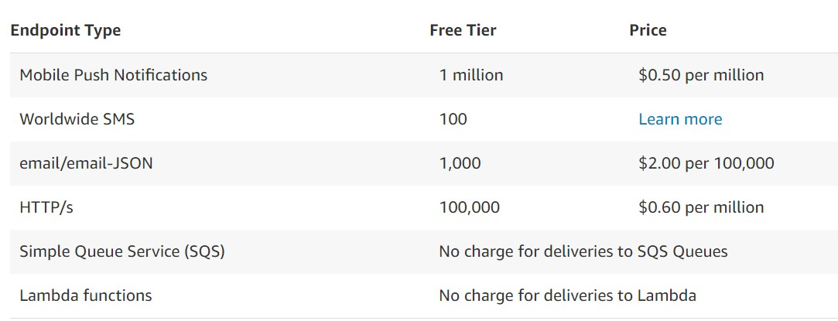
Introduction to EC2
Notification Deliveries
Note: Each 64KB chunk of delivered data is billed as 1 request. For example, a single notification
with a 256KB payload will be billed as four deliveries.
132

Slide 119
Introduction to EC2
Self Assessment Questions
EC2 stands for:
Elastic Compute Cloud
Economic computing
Environment computing
None of the above
Answer: Elastic Compute Cloud
132

Slide 120
Introduction to EC2
Self Assessment Questions
AMI stands for :
Amazon Machine Images
Atom Machine Images
Aviac Machine Images
None of the above
Answer: Amazon Machine Images
132

Slide 121
Introduction to EC2
Self Assessment Questions
EC2 is used for :
To create machine images
To create elastic block storage
To create elastic ips
None of the above
Answer: To create machine images
132

Slide 122
Introduction to EC2
Self Assessment Questions
Which of the following low cost processor?
T2 instance
M4 instance
M3 instance
C4 instance
Answer: T2 instance
132

Slide 123
Introduction to EC2
Self Assessment Questions
Which of the following is faster instance?
T2
M4
M3
C3
Answer: C3
132

Slide 124
Introduction to EC2
Self Assessment Questions
Public IP of an instance is used:
To access the instance through LAN
To access the instance through internet
To access the instance through MAN
To access the instance through WAN
Answer: To access the instance through internet
132

Slide 125
Introduction to EC2
Self Assessment Questions
To create a virtual machine which of the following services is to be used?
Bucket
RDS
EC2
IAM
Answer: EC2
132

Slide 126
Introduction to EC2
Self Assessment Questions
Choose the right option for Route 53:
A protocol
A method in DNS
A path
A scalable DNS web service
Answer: A scalable DNS web service
132

Slide 127
Introduction to EC2
Self Assessment Questions
Simple Notification Service is used for _.
To send notification to end user
Is a protocol
Is a method
None of the above
Answer: To send notification to end user
132

Slide 128
Introduction to EC2
Self Assessment Questions
SNS provides notification messages as a free tier per month.
2 million
1 million
3 million
None of the above
Answer: 1 million
132

Slide 129
Introduction to EC2
Self Assessment Questions
What is/are the function (s) of CloudFront?
It retrieves data from Amazon S3 bucket.
It retrieves data from different datacenter locations.
It retrieves data from Amazon S3 bucket and distributes it to multiple datacenter locations.
None of the above
Answer: It retrieves data from Amazon S3 bucket and distributes it to multiple datacenter locations.
132

Slide 130
Introduction to EC2
Self Assessment Questions
Which AWS Service that securely delivers data, videos, applications, and APIs to your viewers with low latency and high transfer speeds.
VPN
DNS
CDN
CloudFront
Answer: CloudFront
132

Slide 131
Introduction to EC2
Assignment
List different types of instance type.
Mention what are the key components of AWS?
Explain Amazon machine images.
Mention what is the relation between an instance and AMI?
Differentiate Elastic , public and private IP of an instance.
Make document how an instance is created in Ec2, show each step.
Make document how to allocate elastic IP for a instance.
Mention what are the security best practices for Amazon EC2?
Explain SNS pricing.
Explain Route 53 DNS service.
132

Slide 132
Introduction to EC2
Summary
Amazon Elastic Compute Cloud (Amazon EC2) provides scalable computing capacity in the Amazon Web Services (AWS) cloud.
Amazon Elastic Compute Cloud run command lets you remotely and securely manage the configuration of your Amazon EC2 instances, virtual machines (VMs) and servers in hybrid environments, or VMs from other cloud providers.
You can use Amazon EC2 to launch as many or as few virtual servers as you need, configure security and networking, and manage storage.
Amazon EC2 Auto Scaling helps you ensure that you have the correct number of Amazon EC2 instances
available to handle the load for your application.
Amazon Machine Image (AMI) provides the information required to launch an instance, which is a virtual server in the cloud.
Amazon Elastic Block Store (Amazon EBS) provides block level storage volumes for use with EC2 instances.
Amazon Route 53 is a highly available and scalable cloud Domain Name System (DNS) web service.
132

Slide 133
Introduction to EC2
Document Link
Chapter | Topic | URL
Introduction to EC2 | EC2 instance | https://www.guru99.com/modifyingamazonec2instanceparameters.ht ml
 | Ec2 instance types | https://aws.amazon.com/ec2/instance-types/
 | Amazon machine images | https://docs.aws.amazon.com/AWSEC2/latest/UserGuide/AMIs.html
 | EBS | https://www.tutorialspoint.com/amazon_web_services/amazon_web _services_elastic_block_store.htm https://www.tutorialspoint.com/amazon_web_services/amazon_web _services_elastic_block_store.htm
 | Route 53 DNS | https://aws.amazon.com/route53/
 | SNS pricing | https://aws.amazon.com/sns/ https://aws.amazon.com/sns/details/
132

Slide 134
Introduction to EC2
Video Link
Chapter | Topic | Video URL
Introduction to EC2 | Introduction to EC2 | https://www.youtube.com/watch?v=KpVNEzpvaY0
 | EC2 instance types | https://www.youtube.com/watch?v=TsRBftzZsQo
 | EBS | https://www.youtube.com/watch?v=HTefwhNticU
 | Elastic IPs | https://www.youtube.com/watch?v=MTBR9jyD5RM
 | Route 53 DNS | Https://www.youtube.com/watch?v=HwZ3wNaM69s
132

Slide 135
Introduction to EC2
E-Book Link
https://awsdocs.s3.amazonaws.com/gettingstarted/latest/awsgsg-intro.pdf
http://fit.mta.edu.vn/files/DanhSach/Book_Amazon%20webservices%20for%20dummies.pdf
132

